Slide 1
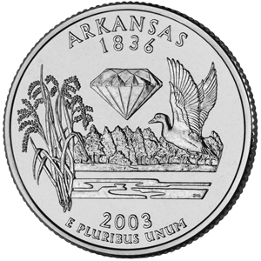
Arkansas Geography

Slide 2
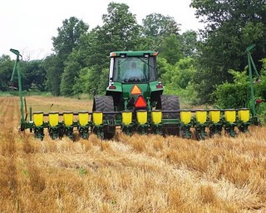
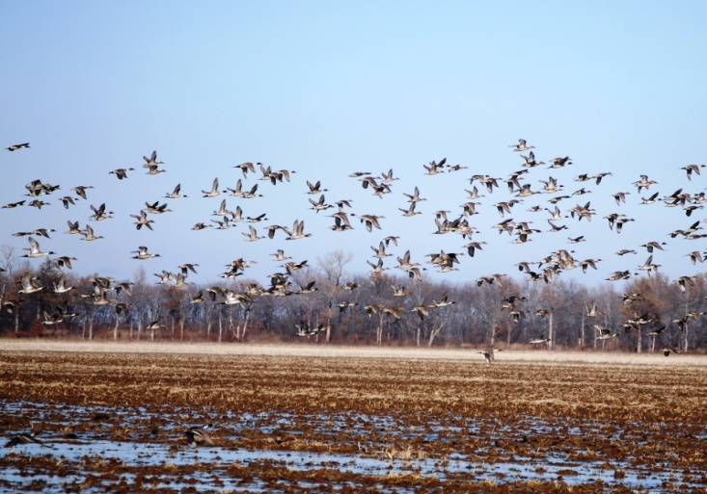
How does Geography Affect Arkansas History?
Geography is the study of the human living trends and the physical characteristics of the earth
Geography has impacted the history of Arkansas from how we travel, where we live, what we grow and what we produce
It has influenced our history, economy, lifestyles, the foods we eat our image, reputation and citizens

Slide 3
How does Geography Affect Arkansas History?
5 Themes of Geography
Used to analyze and categorize geographic information
Human/Environment Interaction
Location
Movement
Place
Region

Slide 4
How does Geography Affect Arkansas History?
Human/ Environment Interaction
How we adapt or modify the environment
Can be positive or negative
Location
Two types- absolute or relative
Absolute- where you are using latitude and longitude
Relative- where you are in relation to something else

Slide 5
How does Geography Affect Arkansas History?
Movement
Movement of people, exchange or development of ideas or goods
Creates interdependence
Can create conflict

Slide 6
How does Geography Affect Arkansas History?
Place
Distinctive human or physical characteristics
Human- culture, beliefs, music, foods
Physical- mountains, rivers, lakes, plants
Region
Arkansas has six distinctive geographic regions
Ozark Mountains
Arkansas Valley
Ouachita Mountains
Gulf Coastal Plain
Mississippi Alluvial Plain (Delta)
Crowley’s Ridge

Slide 7
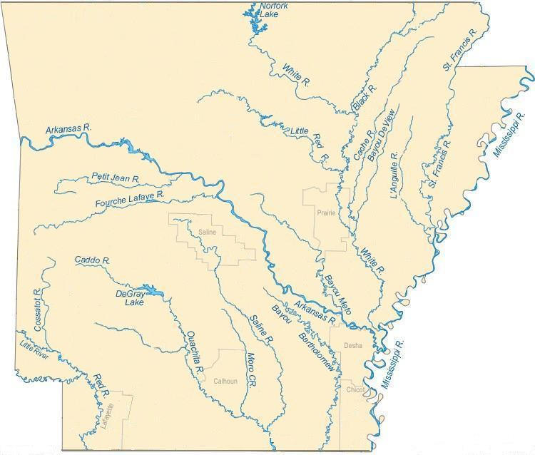
Rivers of Arkansas

Slide 8
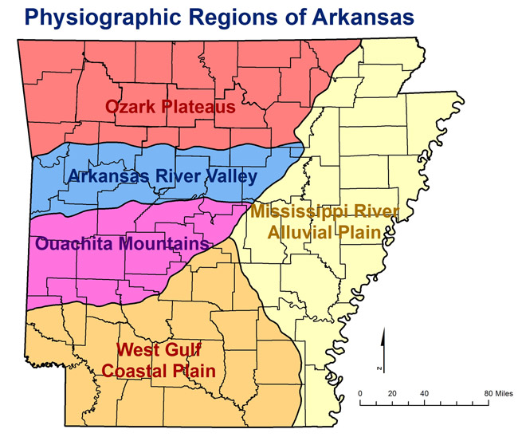
Six Geographic Regions of Arkansas

Slide 9
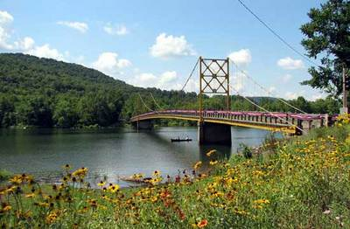
Six Geographic Regions of Arkansas
Ozark Mountains
Almost all of northwestern Arkansas
Oldest landform in the state
Not really mountains but an eroded plateau
Buffalo, Kings and White Rivers create small, fertile river valleys
Major City is Fayetteville

Slide 10
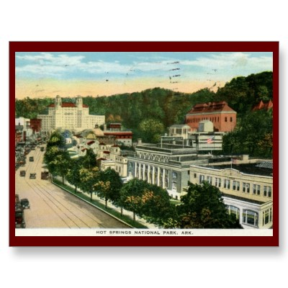
Six Geographic Regions of Arkansas
Ouachita Mountains
South of the Ozarks
Among the oldest mountains in North America
Water and weather have worn them down and made the soil of the region sandy
Rich in underground minerals
Major river is the Ouachita
Major city is Hot Springs

Slide 11
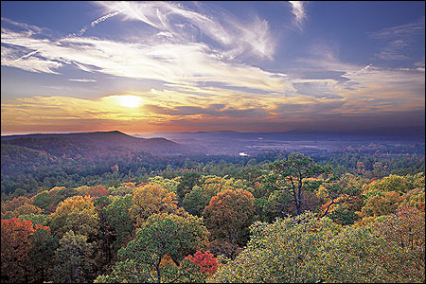
Six Geographic Regions of Arkansas
Arkansas River Valley
Arkansas River largest river in the state
Joins the Mississippi River in southeast Arkansas
Long river valley framed by flat topped mountains
Contains states largest mountain- Mt. Magazine
River Valley contains good farmland
Major city- Ft. Smith, Russellville, Conway

Slide 12
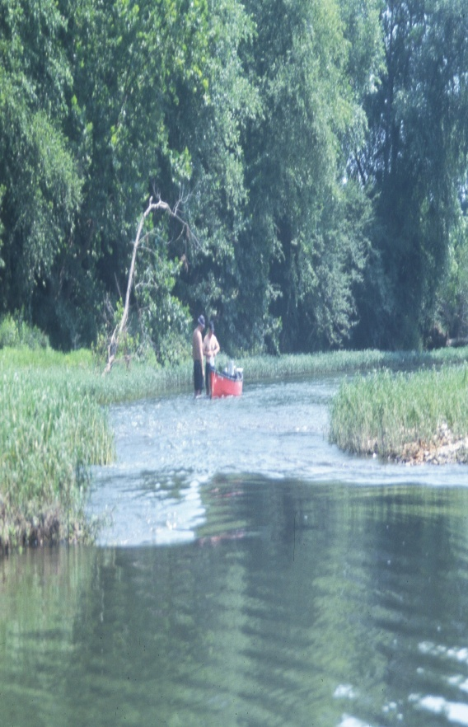
Six Geographic Regions of Arkansas
Gulf Coastal Plain
Southwestern and Southern Arkansas
Ouachita, Red and Saline Rivers found in this region
River valleys form narrow strips of rich, fertile soil
Most of the region has poor farming
Timber production is a major economic activity
Area was once covered by the Gulf of Mexico, when the waters receded it left behind deposits of oil and salt that have been valuable to Arkansans

Slide 13
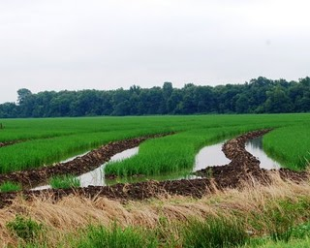
Six Geographic Regions of Arkansas
Mississippi Alluvial Plain
Eastern Arkansas
Broad, flat area of rich, fertile soil
Soil known as alluvium has been deposited by flooding rivers
Some of the best farmland in America
Grand Prairie is a natural grassland found there
Major rivers- White, St. Francis, Cache
Major cities- Pine Bluff, Helena

Slide 14
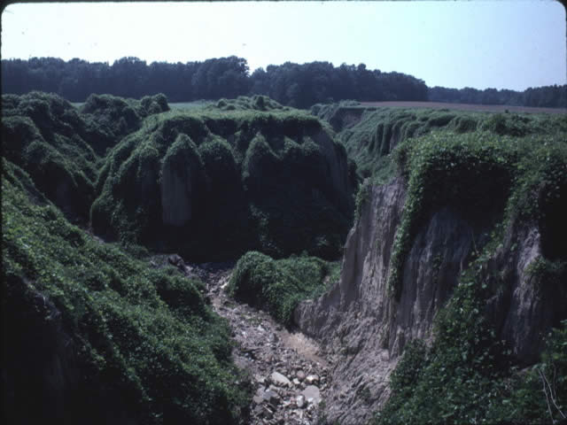
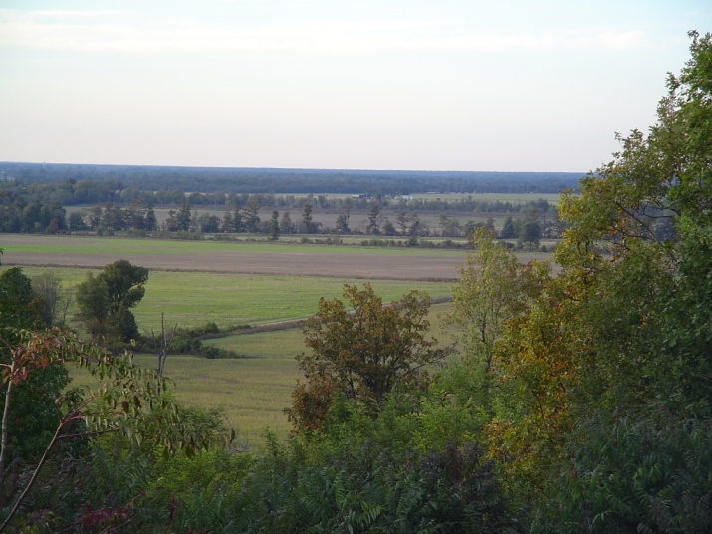
Six Geographic Regions of Arkansas
Crowley's Ridge
Runs north and south along the upper delta
Ancient Mississippi and Ohio Rivers ran on each side leaving the ridge in the middle
Covered by fine, windblown dirt called loess
Ridge for a long time was a safe have from flooding rivers in the region
Major cities- Jonesboro

Slide 15
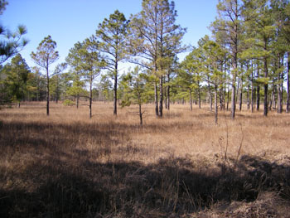
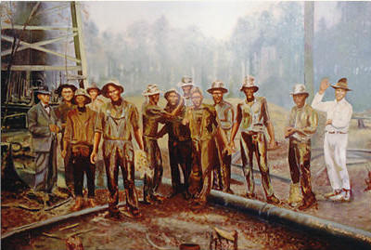
Arkansas Natural Resources and Land Use
State has abundant natural resources
Only diamond producing state in the nation
Top three minerals produced are petroleum, natural gas and bromine
Arkansas has timber production
Some coal and sand and gravel
Soil and land are also a natural resources

Slide 16
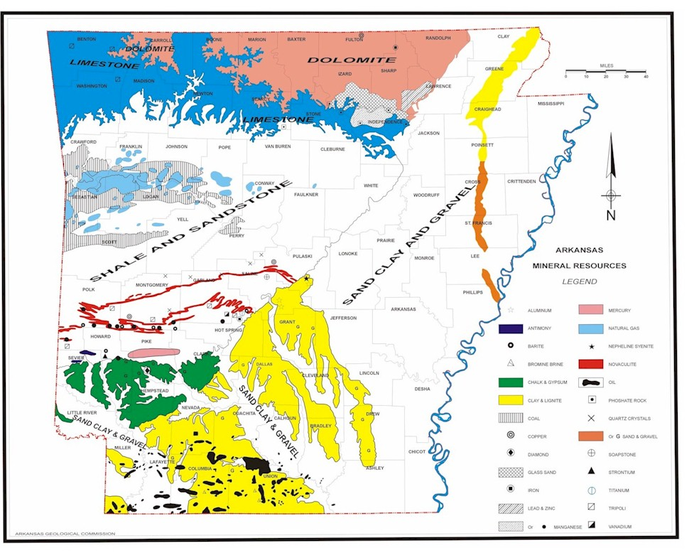
Arkansas Natural Resources and Land Use

Slide 17
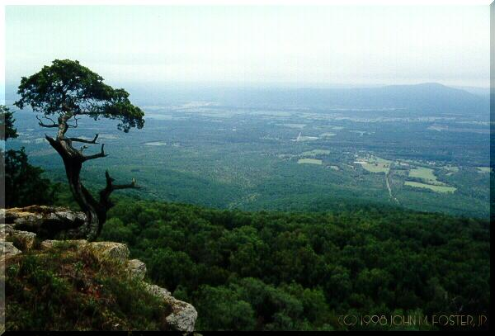
Arkansas Climate and Unique Geographic Features
Arkansas climate is classified as humid subtropical
Warm summers and mild winters
Weather varies across the state
Most rain along lower Mississippi Alluvial Plain
Most snow is in Ouachita and Ozark Mountains
Geographic center of Arkansas is in Pulaski County outside of North Little Rock
Highest point is Mt. Magazine (2,753 feet)
Lowest point is on the Louisiana border in Union County at 54 feet above sea level

Slide 18
Arkansas Economy
Agriculture is the state’s leading industry
One of the nations leading producers of rice, poultry, cotton and soybeans
Some of the countries largest companies began in Arkansas and are based here
Wal Mart
Tyson Foods
JB Hunt Trucking
Murphy Oil

