Slide 1
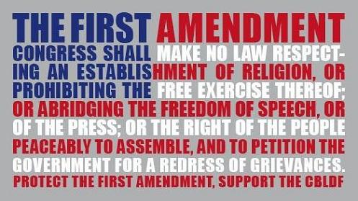
The Bill of Rights
Chapter 4

Slide 2
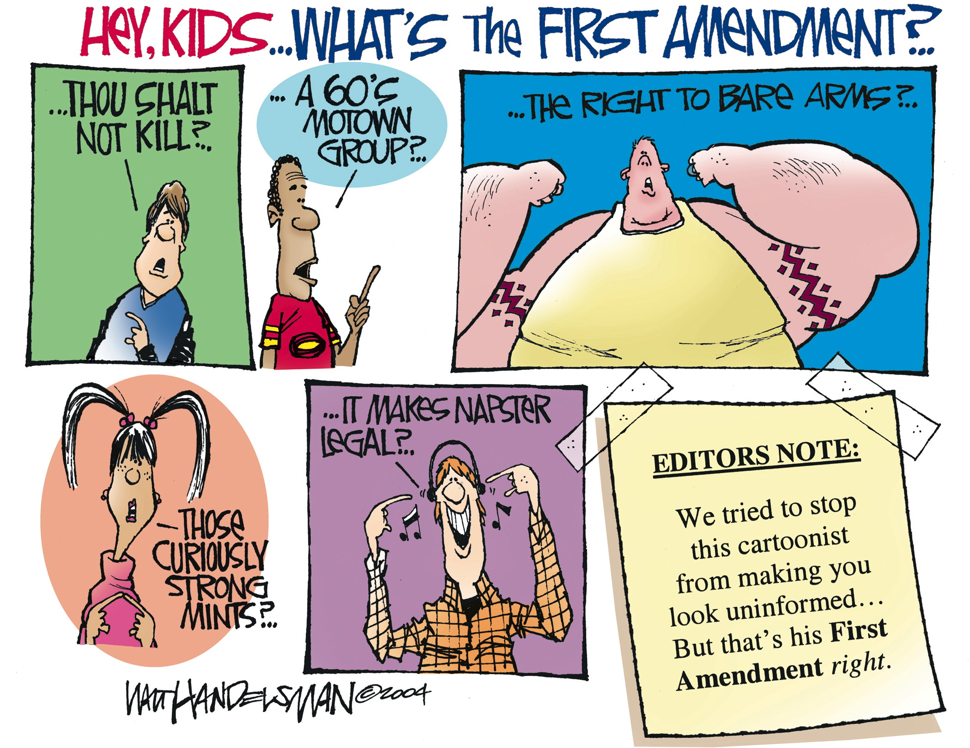

Slide 3
First Amendment Freedoms
Founders of US believed in protecting individual rights, providing for safety and well being of citizens
Bill of Rights places limits on powers of gov’t.
Protects civil liberties
Five basic freedoms protected in 1st Amendment: speech, religion, assembly, press and to petition the government

Slide 4
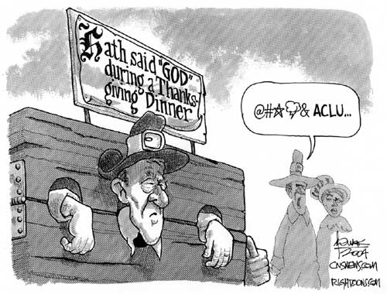
First Amendment Freedoms
Freedom of Religion
The U.S. has freedom of religion, first colonists came to the U.S. from religious persecution
Prohibits gov’t from establishing official religion in US
Freedom of Religion allows Americans to practice any faith as they wish

Slide 5
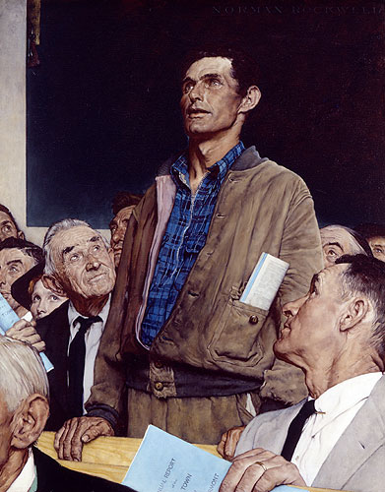
First Amendment Freedoms
Freedom of Speech
First amendment guarantees that we can say whatever we want without gov’t persecution
Internet communication, art, music clothing interpreted by Supreme Court as speech
1969: Supreme Court declared armbands a form of speech
Allowed students to protest the Vietnam War by wearing black armbands (Tinker vs. Des Moines Independent Community School District, 1965)

Slide 6
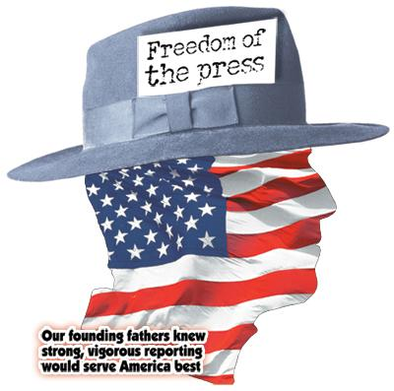
First Amendment Freedoms
Freedom of the Press
Freedom of the press allows books, newspapers, magazines, radio, TV, and computer networks to print and broadcast anything without fear of censorship by the gov’t
This allows the U.S. to have a wide variety of beliefs and ideas

Slide 7
First Amendment Freedoms
Freedom of Assembly
Right to gather in groups for any reason as long as the assemblies are peaceful
Right to form and join social clubs, political parties, labor unions, and other organizations
Freedom to Petition
Right to express your ideas to the government, do they always respond?

Slide 8
Limits to First Amendment Freedoms
Security Comes First
Supreme Court has decided safety and security of Americans limitat First Amendment freedoms
You do not have freedom to provoke a riot or violent behavior, speak or write in a way that leads to criminal activities or overthrow government
Use civil liberties responsibly, they cannot interfere with the rights of others
You may criticize gov’t officials but you may not spread lies that harm that person’s reputation
Slander is spoken and libel is printed
The 1st Amendment never intended to allow Americans to do whatever they please, the nation and its communities come before the rights of the individual

Slide 9
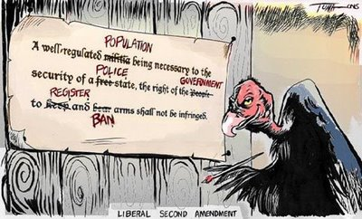
Other Guarantees in the Bill of Rights
Second Amendment
Debate over what it means;
Some argue its only for states to maintain “a well regulated militia” allowing the members to carry arms
Others say it guarantees the right for all citizens to “keep and bear arms” without gov’t interference
Courts have ruled that the gov’t can pass laws to control but not prevent firearm possession

Slide 10
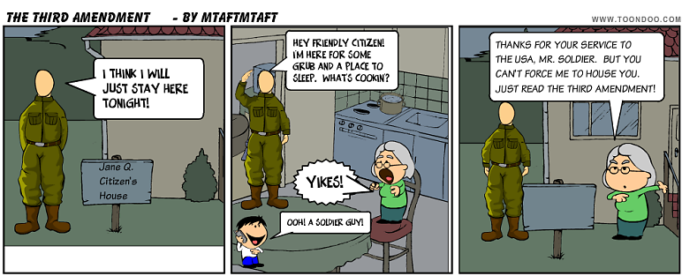
Other Guarantees in the Bill of Rights
Third Amendment
Housing and feeding troops was one cause of American Revolution
Says that in peacetime, soldiers may not be housed in private homes without consent of the homeowner
During war, it must be authorized by government

Slide 11
Other Guarantees in the Bill of Rights
Protecting the Rights of the Accused
The right to fair legal treatment protected by the Bill of Rights
4th, 5th and 6th Amendments
The Fourth Amendment
Protects against unreasonable searches and seizure, gov’t and police cannot search your home or take your property without good cause
Police can ask a judge to issue a search warrant if they believe that you have committed a crime which gives them the right to search your property

Slide 12
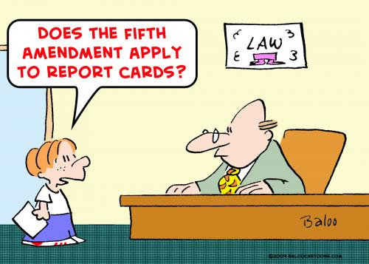
Other Guarantees in the Bill of Rights
The Fifth Amendment
Protects rights of the accused
Cannot be put on trial for serious federal crime without and indictment from a grand jury
Protects people from double jeopardy, accused of a crime and found not guilty may not be put on trial again for the same crime

Slide 13
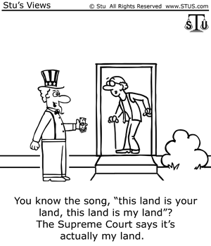
Other Guarantees in the Bill of Rights
Protects accused person’s right to remain silent, against self-incrimination, (testifying against yourself)
May not be denied life, liberty, or property without due process of law (following legal procedures)
Protects citizens’ property rights by limiting the gov’ts power of eminent domain: (right of the gov’t to take private property for public use)

Slide 14
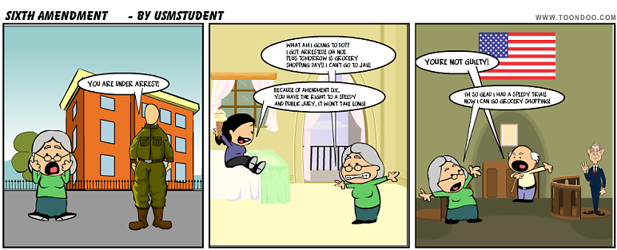
Other Guarantees in the Bill of Rights
The Sixth Amendment
Gives due process to people accused of crimes, it requires that:
They be told of the charges
It guarantees them trial by jury
A speedy and public trial,
Right to hear and question witnesses, call witnesses in their defense
Have an attorney even if they cannot afford one
Supreme Court ruled after amendment written that the gov’t must pay for attorney

Slide 15
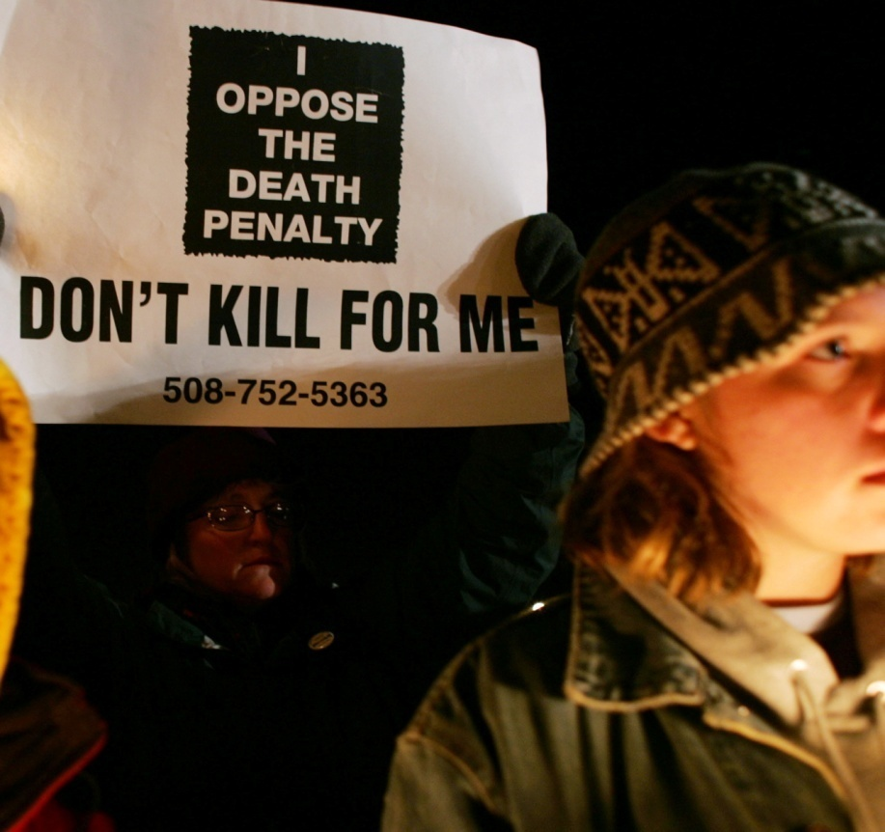
Other Guarantees in the Bill of Rights
The Eighth Amendment
prohibits excessive bail
Bail- sum of money used as a deposit before a trial in order to get out of prison
If the accused appears for court then bail is returned, if not it is forfeited
Forbids excessive fines for people convicted of crimes and cruel and unusual punishment

Slide 16
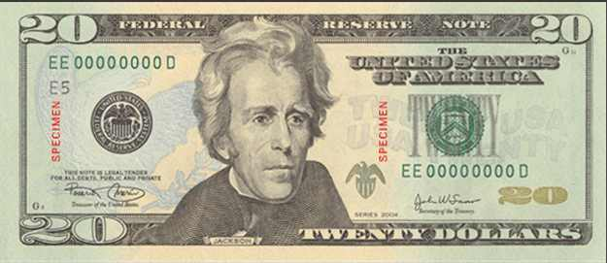
Other Guarantees in the Bill of Rights
Seventh Amendment
Concerns civil cases (disagreements between individuals)
Right to jury trial in cases that involve more than $20
Does not require jury trial
Judge can decide case

Slide 17
Other Guarantees in the Bill of Rights
Ninth Amendment
Says that citizens have other rights beyond those listed in the Constitution, i.e. the right to privacy
Protects medical records, freedom from gov’t interference in our personal affairs
These unwritten rights may not be taken away

Slide 18
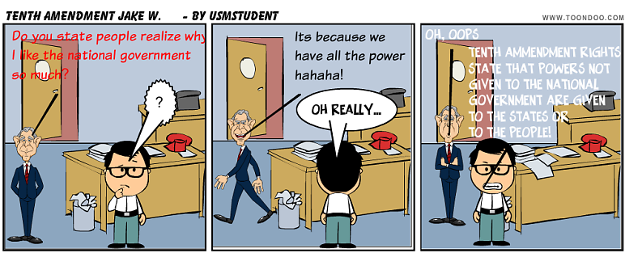
Other Guarantees in the Bill of Rights
Tenth Amendment
Any powers not specifically given to the national gov’t are reserved to the states or the people
Education, Marriage, and Slavery are such issues
Prevents Congress and the President from becoming too strong

Slide 19
Extending the Bill of Rights
For many years after the passage of the Bill of Rights, state and local gov’ts were not bound by its terms and some states passed laws that violated civil liberties
The 13th, 14th, 15th, Amendments known as the Civil War Amendments
African Americans were slaves in the south until 1865 when three Civil War Amendments were passed

Slide 20
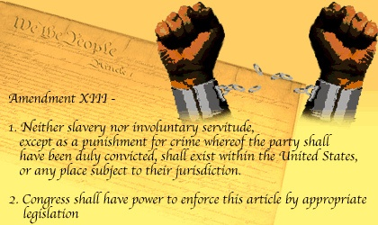
Extending the Bill of Rights
13th: officially outlawed slavery in the United States and this freed thousands of African Americans
Outlawed forced labor except as punishment

Slide 21
Extending the Bill of Rights
14TH Amendment (1868)
Passed to prevent southern states from keeping African Americans from holding jobs, denying them property , and other restrictions
Every state must grant its citizens “equal protection of the laws”
Defines a U.S. citizen as anyone “born or naturalized in the U.S.”
The intent was to make the Bill of Rights binding for state AND national gov’t (nationalization of Bill of Rights)
Ignored until 1925 when the Supreme Court ruled in Gitlow v. New York that the 14th Amendment applies to free speech
After this case Supreme Court interpreted that all of the Bill of Rights applied to the state and federal level

Slide 22
Extending the Bill of Rights
15th Amendment (1870)
Says that no state may take away a person’s voting rights on the basis of race, color, or previous enslavement
This amendment was aimed to give suffrage to African Americans but southern states still found ways around it
Did not apply to women

Slide 23
Extending the Bill of Rights
17th Amendment (1913)
Allows voters to elect their senators directly instead of the previous system where state legislatures had elected them
Gave people greater voice in gov’t
19th Amendment (1920)
Gave women the right to vote in all national and state elections

Slide 24
Extending the Bill of Rights
The 23rd Amendment (1961)
Allows the residents of Washington D.C. to vote for president and vice president
The 24th Amendment (1964)
Made poll taxes illegal in national and state elections; this prevented some southern states from keeping poor citizens from voting
The 26th Amendment (1971)
Sets the voting age at 18, this allowed teens who were fighting for the army to be able to vote
This was done while America was involved in the Vietnam Conflict

Slide 25
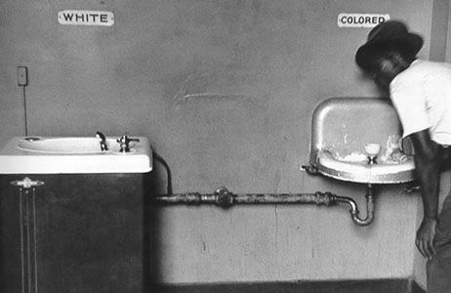
The Civil Rights Struggle
Background of the Struggle
Post civil war, African Americans faced discrimination
Discrimination – unfair treatment based on prejudice against a certain group
South had “Jim Crow” laws
Separation in pubic places
Segregation
Legal separation of the races
Civil Rights were needed
The rights of full citizenship and equality under the law
Notes:
Jim Crow laws required African Americans and whites to be separated in most public places, such as schools. Later had to ride in the back of buses, sit in separate sections of restaurants and theaters, and even had separate public restrooms and water fountains.
25

Slide 26
The Civil Rights Struggle
African Americans seen as “second-class citizens”
National Association for the Advancement of Colored People (NAACP) established in 1909 by African Americans and whites
Worked through courts to challenge laws and customs
1910 the National Urban League founded
To aid in finding jobs and getting ahead in life
1950’S and 1960’s Civil Rights Movement gradually developed from these and other groups and other involved people
Millions supported the movement
Notes:
26

Slide 27
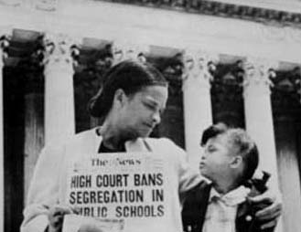
The Civil Rights Struggle
1948 – Truman ordered end to segregation in armed forces
1954 – Brown v. Board of Education of Topeka, Kansas
Argued segregated public schools unconstitutional
Segregation violated Amendment XIV’s principle of equal protection under the law
1950s – Dr. Martin Luther King, Jr. became one of the main leaders of the civil rights movement.
Baptist minister, great orator
Believed in nonviolent resistance
Helped organize marches, boycotts, and demonstrations
Notes:
Nonviolent resistance is peaceful protest of unfair laws.
27

Slide 28
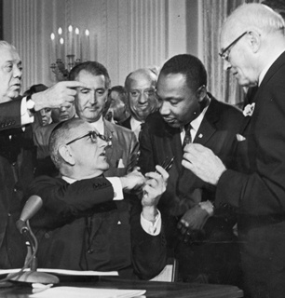
The Civil Rights Struggle
“Sit-ins”
“Freedom Riders”
Some whites responded with violence.
Civil Rights Act of 1964
Passed by Congress
Prohibited discrimination in public facilities, employment, education, voter registration.
Banned discrimination by race, color, gender, religion, and national origin
Amendment XXIV eliminated poll taxes
Notes:
Most sit-ins were at lunch counters that only served whites.
Freedom Riders traveled together on buses to protest segregation.
28

Slide 29
The Civil Rights Struggle
Many gains since the 1960s civil rights movement for all minorities
1970s – affirmative action programs
Encouraged the hiring and promoting of minorities and women in fields that were traditionally closed to them.
Colleges also practiced this.
Affirmative Action controversial from the beginning
Some saw it as reverse discrimination
Gratz v. Bollinger (2003) – Supreme Court struck down a point-based system at the U of MI to give more points to minority applicants
People still face workplace discrimination, racial profiling, hate crimes
Notes:
29

Slide 30
Questions
1 – List examples of discrimination that African Americans faced after the Civil War.
2 – What was the purpose of the Civil Rights Act of 1964?
3 – Why was the Civil Rights Movement started?
4 – After looking at the chart on page 114, which of the acts/cases do you think was most significant? Why?
5 – How did MLK hope to change unfair laws? (what were his tactics?)
6 – On what was “Jim Crow” based?
7 – Can you think of an area where civil rights is lacking today?
Notes:
30

